Slide 1
FIRE SAFETY FIRE TRIANGLE UNIT- III

Slide 2
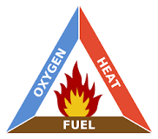
FIRE TRIANGLE
The fire triangles or combustion triangles or ″fire diamond″ are simple models for understanding the necessary ingredients for most fires. The triangle illustrates the three elements a fire needs to ignite: heat, fuel, and an oxidizing agent (usually oxygen).
What is the fire triangle and how do we use it?
The fire triangle is used to show the three elements that when present together can cause a fire to start. These three ingredients are fuel, heat and oxygen, under all circumstances they should be kept apart to avoid a fire starting.

Slide 3
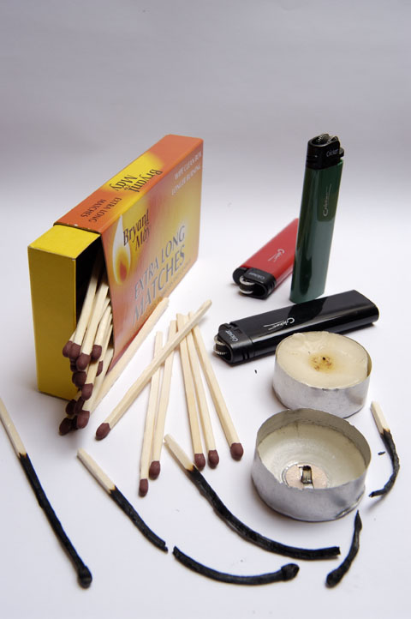
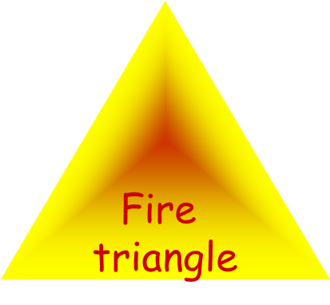
Oxygen =
in the air
Fuel =
Candle wax, wick and wood of the match
Heat =
matches and lighters

Slide 4
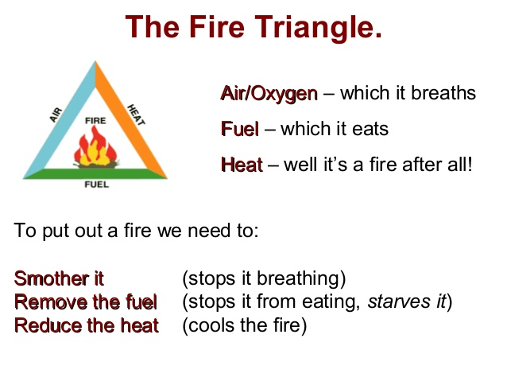

Slide 5
What a fire needs to burn?
All fires need three things to burn: heat, fuel and oxygen. These three elements make up the fire triangle. Remove any one of them and the fire will not burn. Heat first comes from the ignition source that in nature is lightning or lava.
What is the difference between the fire triangle and the fire tetrahedron?
The fire triangle was changed to a fire tetrahedron to reflect this fourth element. A tetrahedron can be described as a pyramid which is a solid having four plane faces. Essentially all four elements must be present for fire to occur, fuel, heat, oxygen, and a chemical chain reaction.
(Fuel)
Oxidizer
Energy
Chain Reaction
Of Burning

Slide 6
What are the elements that make up fire?
Fire is the result of a chemical reaction, called combustion. At a certain point in the combustion reaction, called the ignition point, flames are produced. Flames consist primarily of carbon dioxide, water vapor, oxygen and nitrogen.
Fire emits heat and light.
How does a fire burn?
Oxygen supports the chemical processes that occur during a wild land fire. When fuel burns, it reacts with oxygen from the surrounding air, releasing heat and generating combustion byproducts (e.g., gases, smoke, particles). All wild land fires begin with an ignition source.

Slide 7
CLASSIFICATION OF FIRES
Class A
Class B
Class C
Class D

Slide 8















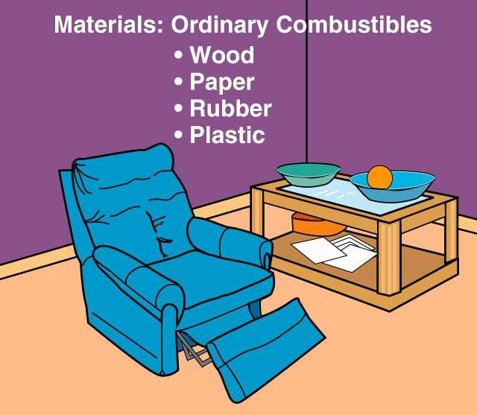

CLASS “A” FIRES
- Ordinary combustibles such as wood, paper, cloth.

Slide 9




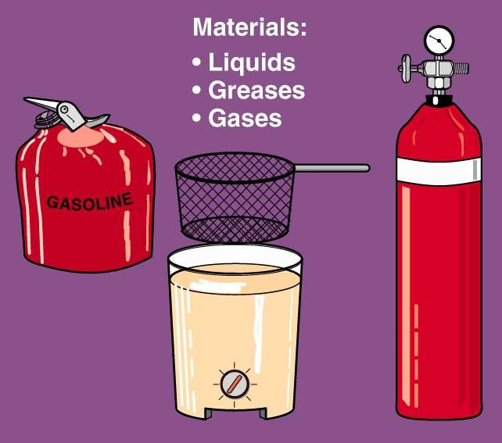

CLASS “B” FIRES - Flammable liquids such as oil, grease

Slide 10



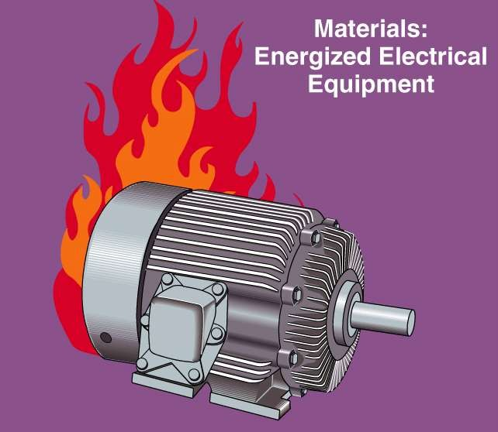

CLASS “C” FIRES
- Energized electrical equipment

Slide 11


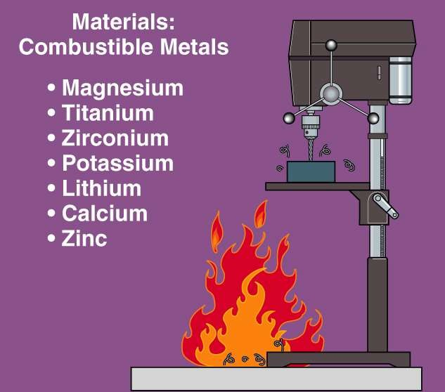

CLASS “D” FIRES
- Flammable Metals

Slide 12



















Each of these three elements must be present at the same time to have a fire. A fire will burn until one or more of the elements is removed.
Fuel
Any combustible material – solid, liquid or gas
Oxygen
The air we breathe is about 21% oxygen – fire needs only
16% oxygen
Heat
The energy necessary to increase the temperature of fuel to where sufficient vapors are given off for ignition to occur

Slide 13
An example of two “Class B” fuels would be:
a. Cardboard, newspapers b. Lamp, hot plate c. Grease, paint thinner

Slide 14
The three elements of the fire triangle are:
a. Water, a heat source, and fuel
b. Oxygen, water, and fuel
c. Oxygen, fuel, and a heat source
d. Fuel, oxygen, and earth

